Slide 1
A Presentation Regarding the Usefulness of Functions
Harrison

Slide 2
PYTHON

Slide 3
IS

Slide 4
VERSATILE

Slide 5
Why is it versatile?
Used in many different ways
Well supported
Simple syntax

Slide 6
What is a function?
Code that only runs when it is called.
You can pass data into the code through parameters

Slide 7
Parts of a Function:
def function(parameters):
# code
Function Name

Slide 8
Parts of a Function:
Parameters
def function(parameters):
# code

Slide 9
Parts of a Function:
def function(parameters):
# code
Actual code

Slide 10
How Functions are Used

Slide 11
Benefits and Advantages

Slide 12
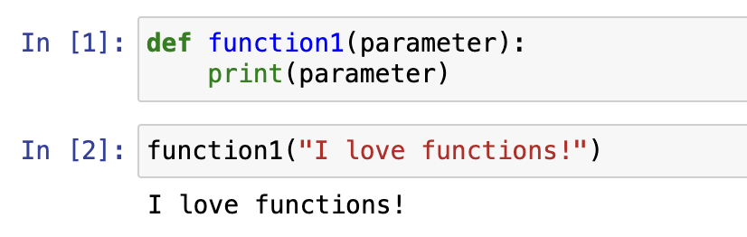

Slide 13
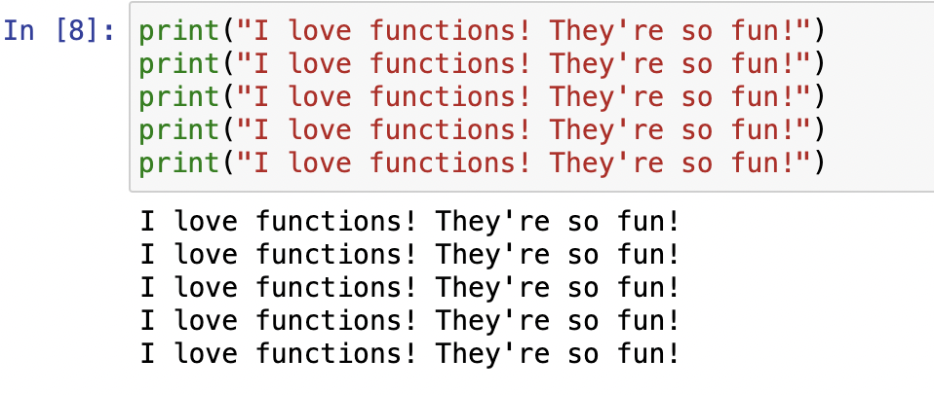

Slide 14
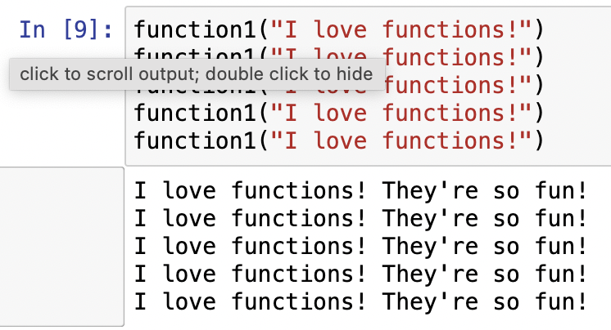

Slide 15
Conclusion
Thanks!

